Slide 1

antedotum
Health Communication Campaign Plan

Slide 2

An Investment in You
"Happiness through healing."
~Karina Perez Marconi, Founder/CEO

Slide 3

Health Issue
Evidence of Need
Stress has been identified as the leading health concern for the employees of ANTEDOTUM. Risk factors stem from the remote business structure. They include lack of definition to work hours and conflicting demands from work and home.
Methods of Assessment
The methods of assessment will also need to be conducted virtually. This will include: 1) a baseline survey to assess existing knowledge, behaviors, and needs; 2) data collection for absenteeism and turnover rates; and 3) interview of CEO & VP for further assessment.

Slide 4

Objectives
Objective 1- Raise awareness about the need, process, and benefits of implementing a stress reduction plan among the employees of ANTEDPTUM by 90%.
Objective 2- Increase knowledge of stress triggers by 75% among the employees of ANTEDOTUM.
Objective 3- Increase amount of involvement in stress reducing initiatives among the employees by 50%.
Objective 4- Reduce stress related measurements among the employees of ANTEDOTUM by 25% after six months of program implementation.

Slide 5






Transtheorhetical Theory Model
Model of Change Framework
In alignment with the Transtheorhetical Theory Model (TTM) the “Stress Reduction Pilot Program” is designed to be interactive and relevant to a diverse demographic (Prochaska & Prochaska, 2014).

Slide 6



Situation Analysis
Stress in the Workplace
Stress in and of itself is not a disease. However, it can trigger adverse health outcomes. Health conditions caused by stress include hypertension, elevated cholesterol, musculoskeletal disorders, diabetes, and inflammatory bowel diseases. The immune system is particularly sensitive to stress which, once compromised, can impact cancer. Psychologically, stress can impact cognitive outcomes such as memory loss, brain fog, insomnia, anxiety and depression.
Studies demonstrate profitability in investing in stress reduction programs for the workplace (Radulovic, 2017).

Slide 8

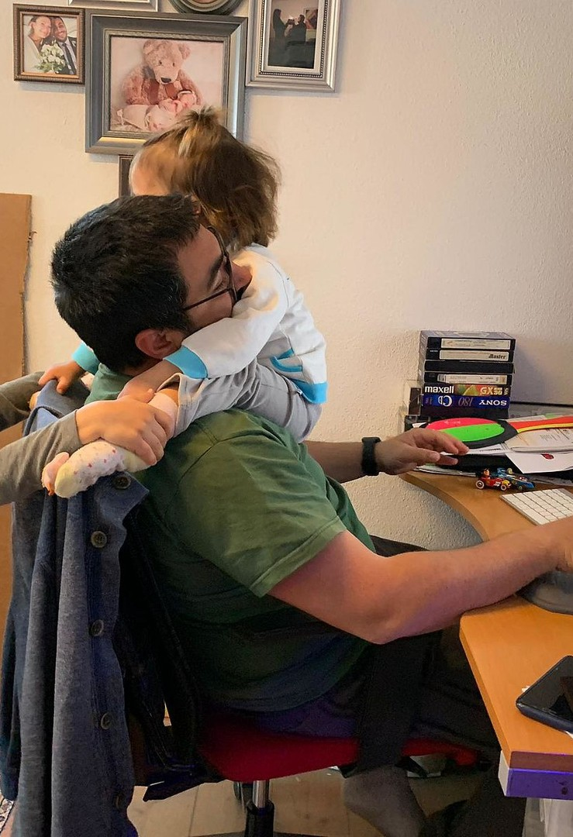


Audience Analysis
Risk Factors for Stress
Organizational structure- HIGH RISK Working conditions- MEDIUM RISK Communication- LOW RISK Subjective factors- LOW RISK

Slide 9


Target Sector
Stress Reduction Pilot Program
Designed specifically for ANTEDOTUM, this wellness program has been customized to meet the primary common health concern of the company within the remote framework within which it operates. The pilot will last 6 months and focus of decreasing stress levels of the employees through education and interactive virtual solutions.

Slide 10


Communication Objectives
Informing the employees
The objective of the communication campaign is to inform the employees of ANTEDOTUM of health risks associated with stress. The communication approach of the wellness program of ANTEDOTUM will utilize a two-pronged strategy: individual and organizational.
Individual- encourage individual behavioral changes
Organizational- influence policy direction of company (CDC, 2017)

Slide 11

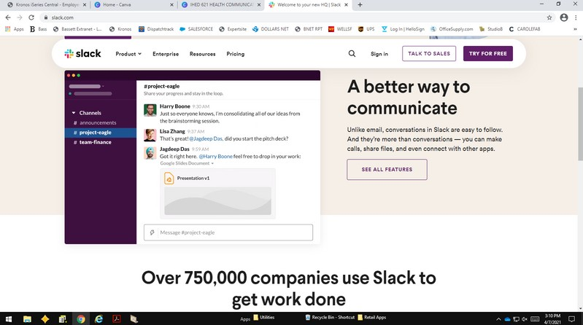
Communication Channels
Communicate the way the employees do!
The communication channels to be used include the following:
Email - daily quote on wellness to keep positive reinforcement top of mind.
Text - once a week each employee will get a “Wellness Wednesday” text from Wellness Program Manager with a tip for reducing work related stress.
Slack.com - monthly posts on the ANTEDOTUM team platform with information about benefits of reducing stress from Wellness Program Manager.
Care Package - monthly wellness box shipped to each employee with a gift from ANTEDOTUM. The gift will tie-in to the topic of the monthly Zen Zone on Zoom session.

Slide 12


Timeline
GANTT Format
The GANTT is a type of bar chart that presents a visual project schedule. The visual presentation will make it easy for the team to see where projects stand. Access will be granted to the CEO, COO, and VP of Sales. It will be placed on an ANTEDOTUM OneDrive and updated by the Wellness Program Manager as tasks get completed.

Slide 13


Budget Considerations
Pulling it all together
The budget for the “Stress Reduction Pilot Program” will be proposed by the Wellness Program Manager. It will be submitted to the Chief Executive Officer (CEO), Chief Operating Operating Officer (COO), and VP of Sales. Final approval will come from Karina Marconi-Perez, the CEO.

Slide 14

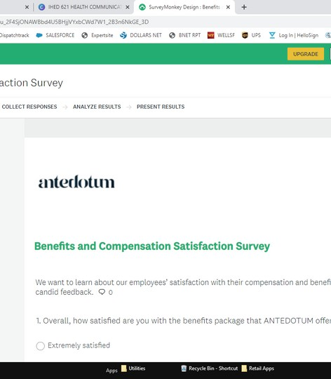



Research Methods
Survey
Questionnaire administered to the employees of ANTEDOTUM to identify job- related stress triggers
Data Collection
Gather information on absenteeism, chronic illness, performance issues, and turnover rates.
Interviews
Gain access to existing attitudes on stress triggers in the workplace and
work-life balance.

Slide 15

Evaluation Components
Stress Reduction Pilot Program
Comparative Data
Logic Model
Credible Evidence
Justify Conclusions
Ensure Use of Evaluation Findings

Slide 16
REFERENCES
Antedotum. (2020). https://antedotum.com/pages/why-antedotum
CDC (2017, Sept. 15). Gateway to Health Communication and Social Marketing Practice. https://www.cancer.gov/publications/health-communication/pink-book.pdf
Prochaska, J.O. and Prochaska, J.M. (2014). Transtheoretical Model. Health Promotion in the Workplace. Troy, MI : American Journal of Health Promotion.
Radulovic, A.H. (2017). Step by Step Procedures and Tools to Reduce Work Related Stress. Occupational Health. [PDF] https://pdfs.semanticscholar.org/25fd/4bd2c33a6303956da30e5ef6cd8e90f1198b.pdf?
_ga=2.111436609.492537931.1615484907-557784856.1615484907

